Slide 1
The ESRC Grand Union DTP: Apply for a Studentship

Slide 2
Structure
What is the GUDTP?
What are the benefits of a GUDTP Studentship?
Preparing an application?
How will your application be assessed?

Slide 3
What is the Grand Union DTP?
DTPs are the way the government funds doctoral training
One of 15 ESRC Doctoral Training Partnerships (DTPs)
GUDTP comprises 3 universities with complementary strengths
23 ‘pathways’ – 18 Oxford, 7 Open University, 2 Brunel
Annually awards 35-40 ESRC Studentships
More than a ‘studentship’ – placements, overseas institutional visits, training

Slide 4
Eligibility for an ESRC studentship
Applications must be for study on an eligible course on of the 23 pathways
Qualifications/experience equal to the standard undergraduate honours degree at a first or upper second class level from a UK research organisation
Masters qualification is not a prerequisite for the award of a studentship from the Grand Union DTP
Anyone can apply – there are no residency or nationality restrictions for a full award (stipend & fees) But the DTP can only offer up to 30% of its awards each year to international students

Slide 5
Studentship Structures
Part time or Full Time
PhD (typically 3.5-year awards) or Masters + PhD (1+3.5 or 2+2.5 awards)
No standalone Masters programmes, applicants must be intending to carry out doctoral research
Some studentships (‘Steer Awards’) are awarded for research specifically focusing on:
Advanced Quantitative Methods
Data Skills
Interdisciplinary Research
Collaborative Studentships – projects advertised on the GUDTP website

Slide 6
Placements
3 months professional experience in any sector
An opportunity to
apply your academic expertise in different settings
make real-world impact
pave the way for your future career
collaborate with non-academic partners
flexible timing
remote/in-person

Slide 7
Placements showcase
Changing the law to support survivors of sexual abuse
3 months
professional experience
in any sector
flexible timing
flexible location
tailored to your
ambitions
interests
needs
with our support
https://youtu.be/2z0HHR2TOmA?si=UkxvWj2Upe3CG7ob

Slide 8
Widening participation to PGR research
We take your professional career profile into account, not just academic trajectory
We assess the potential for doctoral research to have impact and promote knowledge exchange
Part-time provision is available on all pathways
We consider contextual information provided in your application
Ring-fenced awards for Black or mixed Black British students

Slide 9
What does a studentship cover?
A stipend (£19,237 in 2024-25 for 12 months) and university tuition fees are covered.
Placements – all students must carry out a 3 month placement in academia, policy, business or a third sector organisation.
Support for some research-related costs, e.g. fieldwork expenses, additional training, overseas institutional visits (OIVs).
Opportunity to apply for support for student-led events and interdisciplinary initiatives.
Access to an exclusive range of cohort activities, training and events.
Not covered: Visa, health surcharge and travel costs for international students.

Slide 10
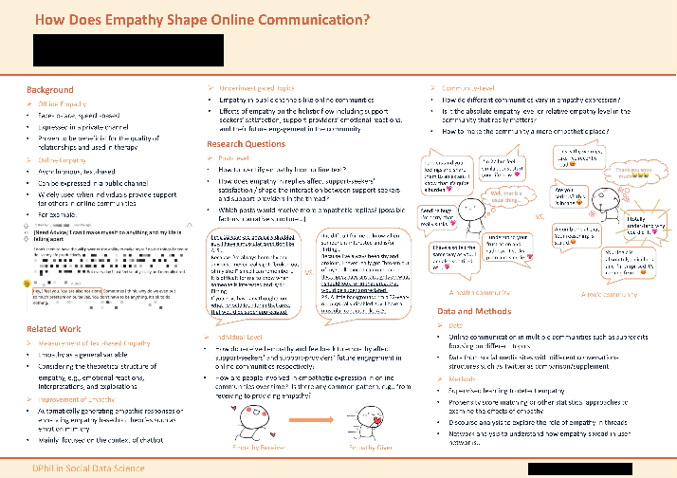
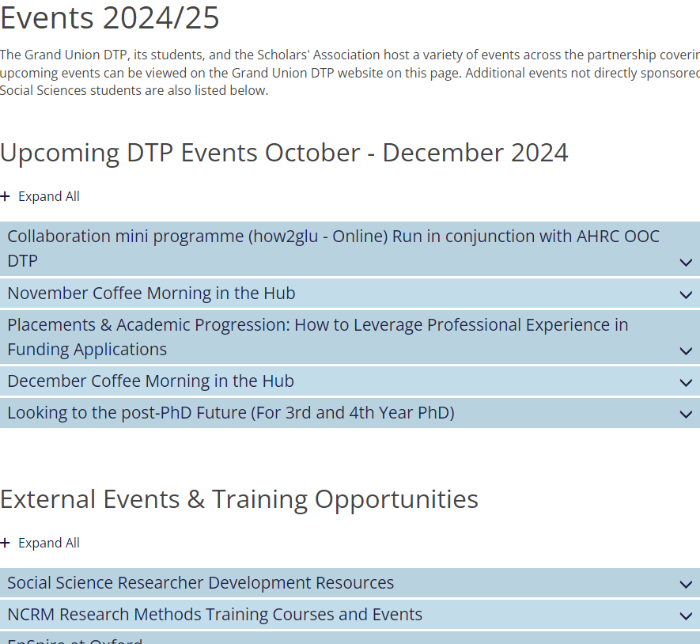
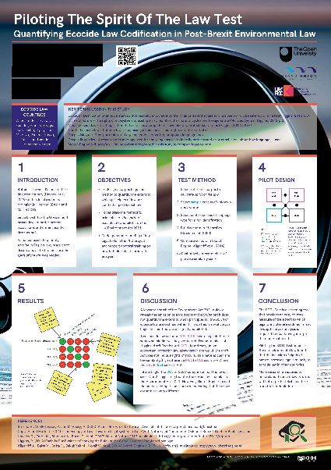
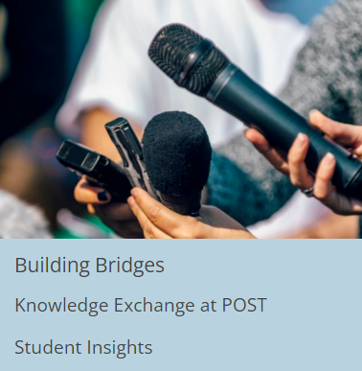
Scholars Association

Slide 11
What makes a good research proposal?
What do I (and others) already know about this topic? How can I draw on my own experience, expertise, and contacts?
What do I need to know and why do I need to know this?
What kind of ‘data’ will answer my questions? Where can I find these data?
How will I analyse this data? What kinds of evidence will this produce?
Things to consider
Which departments have expertise in the chosen research area?
Who would be a suitable supervisor?
Would a predefined or collaborative research topic be suitable?

Slide 12
…and what about methods?
Quantitative, qualitative, mixed methods, theoretical or library-based?
What sources will you draw on?
If sources: where these can be found, how they will contribute to your research, technical skills needed to work with them (e.g. language, use of specialist software)
Focus: local, regional, national, international?
How to secure your research sample?
What practical challenges will there be?
What are the ethical issues to consider?
Do you do a pilot (almost always helpful for empirical research)

Slide 13
The application process
DEADLINE for Autumn 2025 entry: December 2024 to January 2025 (check with your institution on exact date for your course)
Complete and submit GUDTP application with your course application or as per specific institutional instructions.
Your application will be assessed by your department and ‘pathway’ leads.
The strongest applications will be nominated to central studentship competition.
Each nomination is independently read and reviewed by 5 assessors, with representation from all 3 partners and a range of expertise.

Slide 14
Selection criteria
Academic and professional background/experience
Aptitude, potential and contextual information
Quality of doctoral research proposal
Collaboration, impact and knowledge exchange

Slide 15
Questions welcome
E-mail:
Oxford: granduniondtp@socsci.ox.ac.uk
Open University: FASS-PhD-Applications@open.ac.uk
Brunel University London: Emma.Smith@brunel.ac.uk
Website:
https://www.granduniondtp.ac.uk

